Slide 1
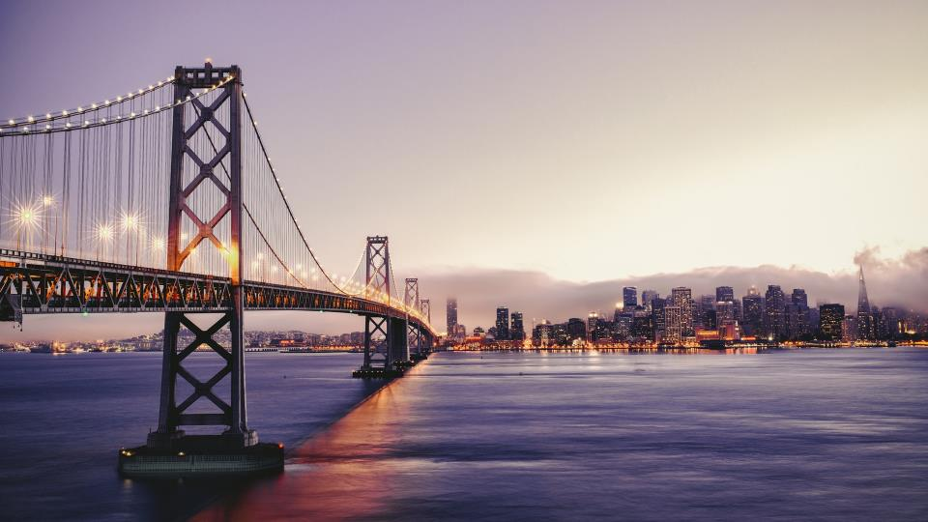

Bay Bridges
Abhishek Gupta

Slide 2
AGENDA
TERMINOLOGY
OVERVIEW
SOLUTION
TOOLS

Slide 4
AGENDA
TERMINOLOGY
OVERVIEW
SOLUTION
TOOLS

Slide 6
AGENDA
TERMINOLOGY
OVERVIEW
SOLUTION
TOOLS

Slide 8
AGENDA
TERMINOLOGY
OVERVIEW
SOLUTION
TOOLS

Slide 9





Slide 10
CYCLE INFOGRAPHIC
TITLE HERE
TITLE HERE
Due to the fact that mobile lorem
Due to the fact that mobile lorem
TITLE HERE
TITLE HERE
Due to the fact that mobile lorem
Due to the fact that mobile lorem
TITLE HERE
TITLE HERE
Due to the fact that mobile lorem
Due to the fact that mobile lorem

Slide 11
PROCESS INFOGRAPHIC
TIME
WEIGHT
CARRY-ON
EXERCISE
Due to the fact that mobile lorem
Due to the fact that mobile lorem
Due to the fact that mobile lorem
Due to the fact that mobile lorem

Slide 12
SPEED INFOGRAPHIC
Due to the fact that mobile lorem social
Due to the fact that mobile lorem social
Due to the fact that mobile lorem social
Due to the fact that mobile lorem social

Slide 13
STATS INFOGRAPHIC
DEFINITION
83%
Due to the fact that mobile lorem social media current location of the user
33%
01
ELEMENT 01
25%
Due to the fact that mobile lorem social media current location
02
ELEMENT 02
Due to the fact that mobile lorem social media current location

Slide 14
BAR STATS INFOGRAPHIC
100%
75%
50%
25%
0%
2001
2002
2003
2004
2005
2006
2007
2008
2009
2010

Slide 15
CYCLE INFOGRAPHIC
1
IMPROVE
DESIGN
2
Due to the fact that mobile lorem
Due to the fact that mobile lorem
3
DEVELOPMENT
STRATEGY
4
Due to the fact that mobile lorem
Due to the fact that mobile lorem

Slide 16
BUSINESS INFOGRAPHIC
TITLE HERE
TITLE HERE
Due to the fact that mobile lorem
Due to the fact that mobile lorem
TITLE HERE
TITLE HERE
Due to the fact that mobile lorem
Due to the fact that mobile lorem

Slide 17
BRAIN INFOGRAPHIC
IDEA 01
IDEA 02
Due to the fact that mobile lorem
Due to the fact that mobile lorem
IDEA 03
IDEA 04
Due to the fact that mobile lorem
Due to the fact that mobile lorem

Slide 18
GROWTH INFOGRAPHIC
Your Title
Your Title
Defined as a greater likelihood that users Fill share content posted to their social
Defined as a greater likelihood that users Fill share content posted to their social
Your Title
Your Title
Defined as a greater likelihood that users Fill share content posted to their social
Defined as a greater likelihood that users Fill share content posted to their social

Slide 19
FIVE OPTIONS INFOGRAPHIC
ELEMENT TITLE
Defined as a greater likelihood that users
ELEMENT TITLE
Defined as a greater likelihood that users
ELEMENT TITLE
Defined as a greater
ELEMENT TITLE
ELEMENT
Defined as a greater likelihood that users
Defined as a
greater

Slide 20
GEAR CYCLE INFOGRAPHIC
DEFINITION
Due to the fact that mobile lorem social media current location of the user
TITLE 01
Due to the fact that mobile lorem social media current location of the user marketing in social networks
TITLE 02
Due to the fact that mobile lorem social media current location of the user marketing in social networks
TITLE 02
Due to the fact that mobile lorem social media current location of the user marketing in social networks

Slide 21
Thanks!
Any questions?
You can find me at:
@username
myemail@domain.com

Slide 22
Credits
Special thanks to all people who made and share these awesome resources for free:
Presentation template designed by Slidesmash
Charts by Rocketo Graphics

Slide 23
Presentation Design
This presentation uses the following typographies and colors:
Free Fonts used:
https://www.fontsquirrel.com/fonts/roboto
Colors used

